Slide 1
Slides to make
Agenda
Problem (Pain points, Customer Journey before) – Abhinaav
Concepts used: Persona, Insights from interviews and external research
Market – Pranav
Solution (Customer Journey after) –Pranav
Concepts used: Concept Solution Design
UI Mockups to explain solution –Abhinaav
MVP vs Future (MVP, Next, Future) –Pranav
Competitor Analysis ( Differentiation/ positioning grid) –Zeyuan
Concepts used: Differentiated value, Positioning and Differentiation
Benefits –Zeyuan
Concepts used: Value Measurement(Value, Measurement, Metrics)
Value Proposition –Zeyuan
Concept used: Pricing
Recommendation –Johnny
Appendix
Cost justification –Johnny
Benefits Justification –Johnny

Slide 2


Slide 3


Slide 4


Slide 5
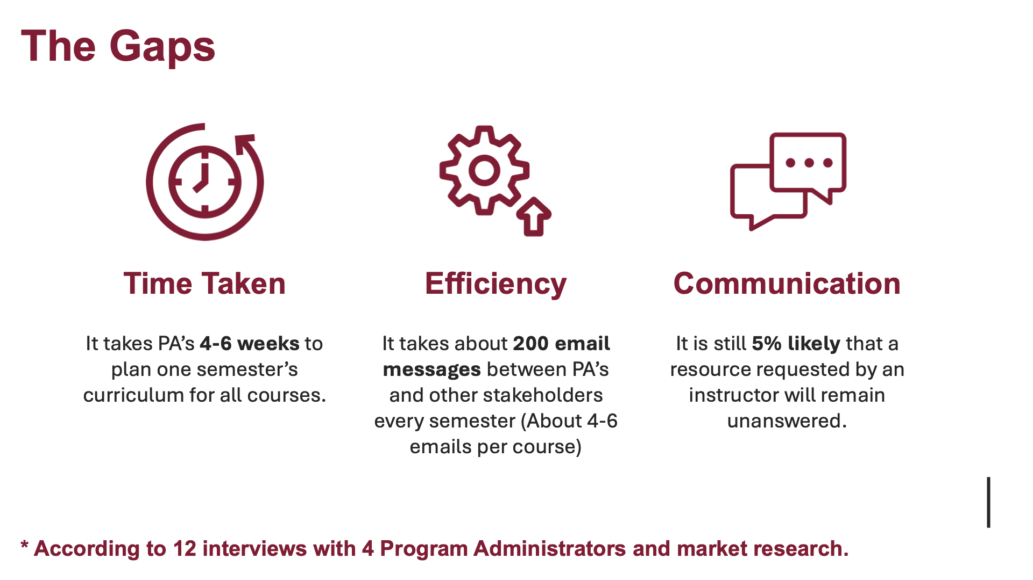

Slide 6
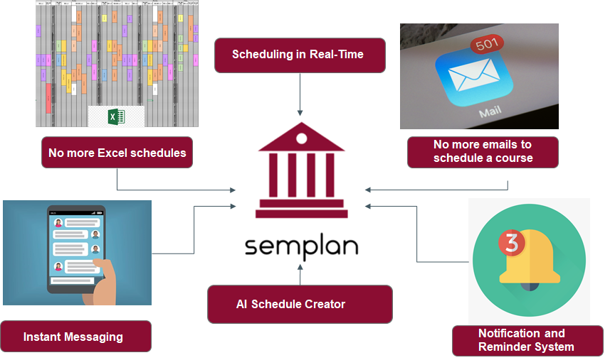

Slide 7
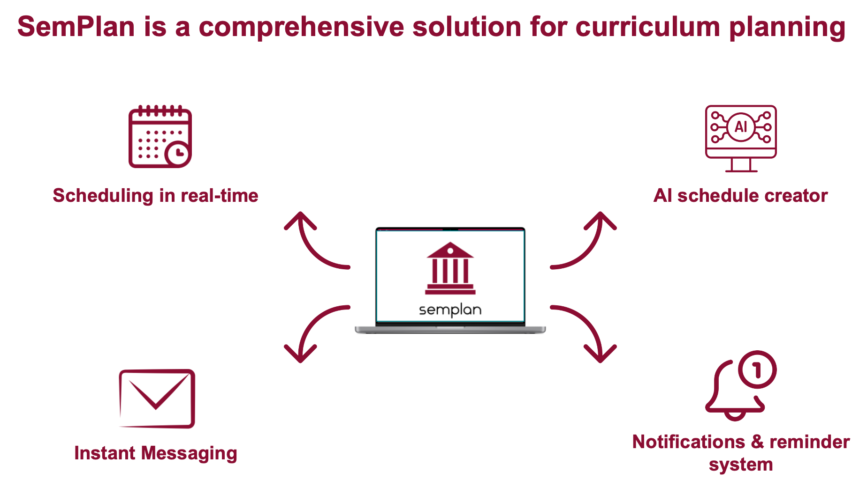

Slide 8
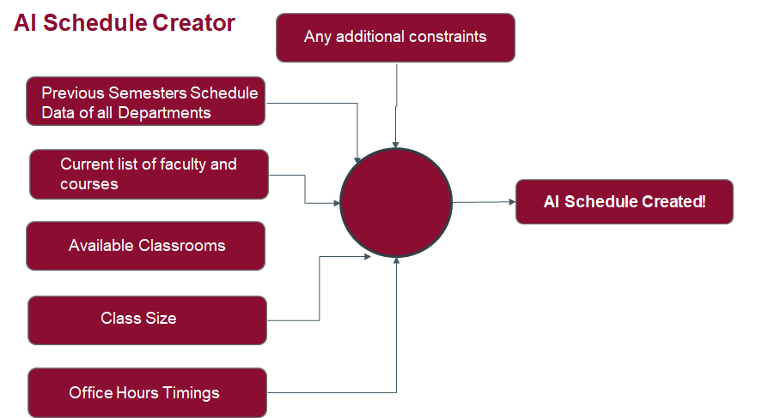

Slide 9
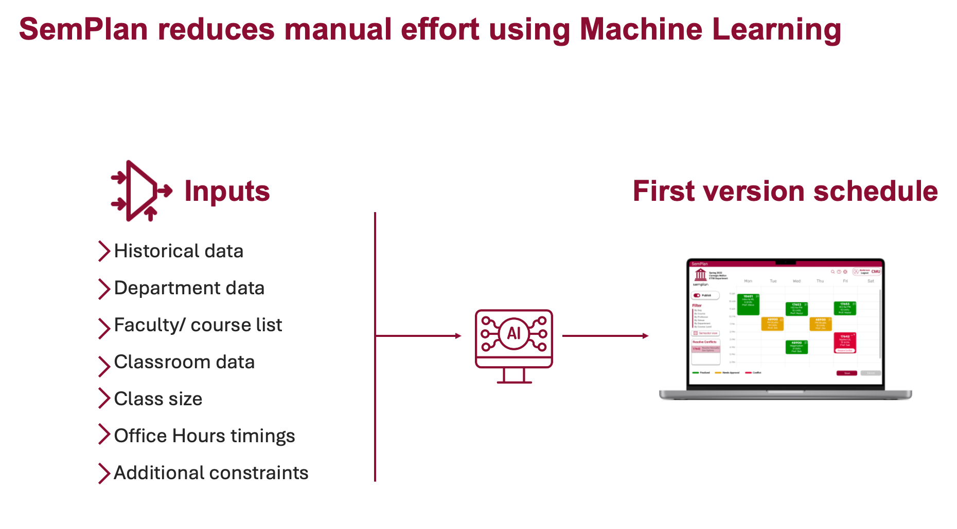

Slide 10

UI Mockup
Showing a typical workflow

Slide 11
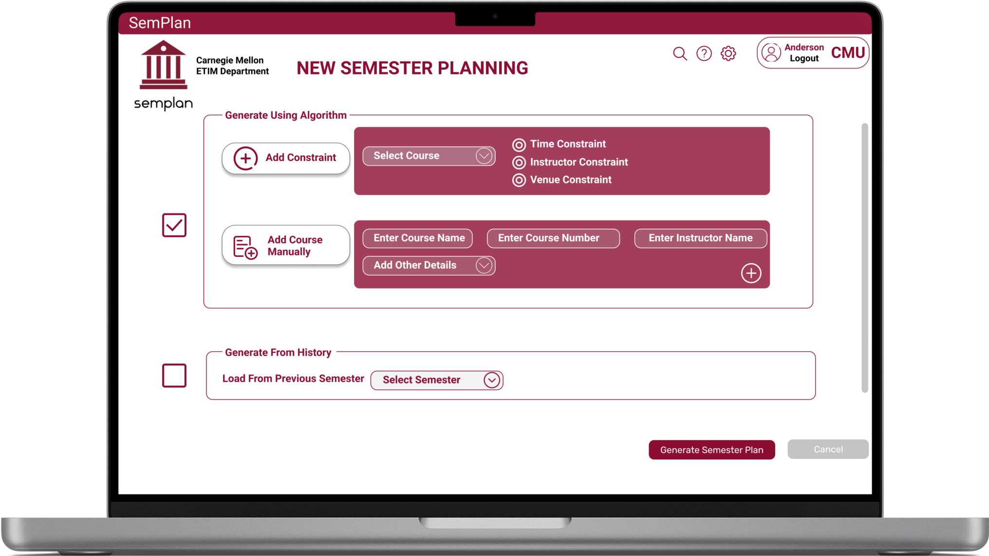

Slide 12
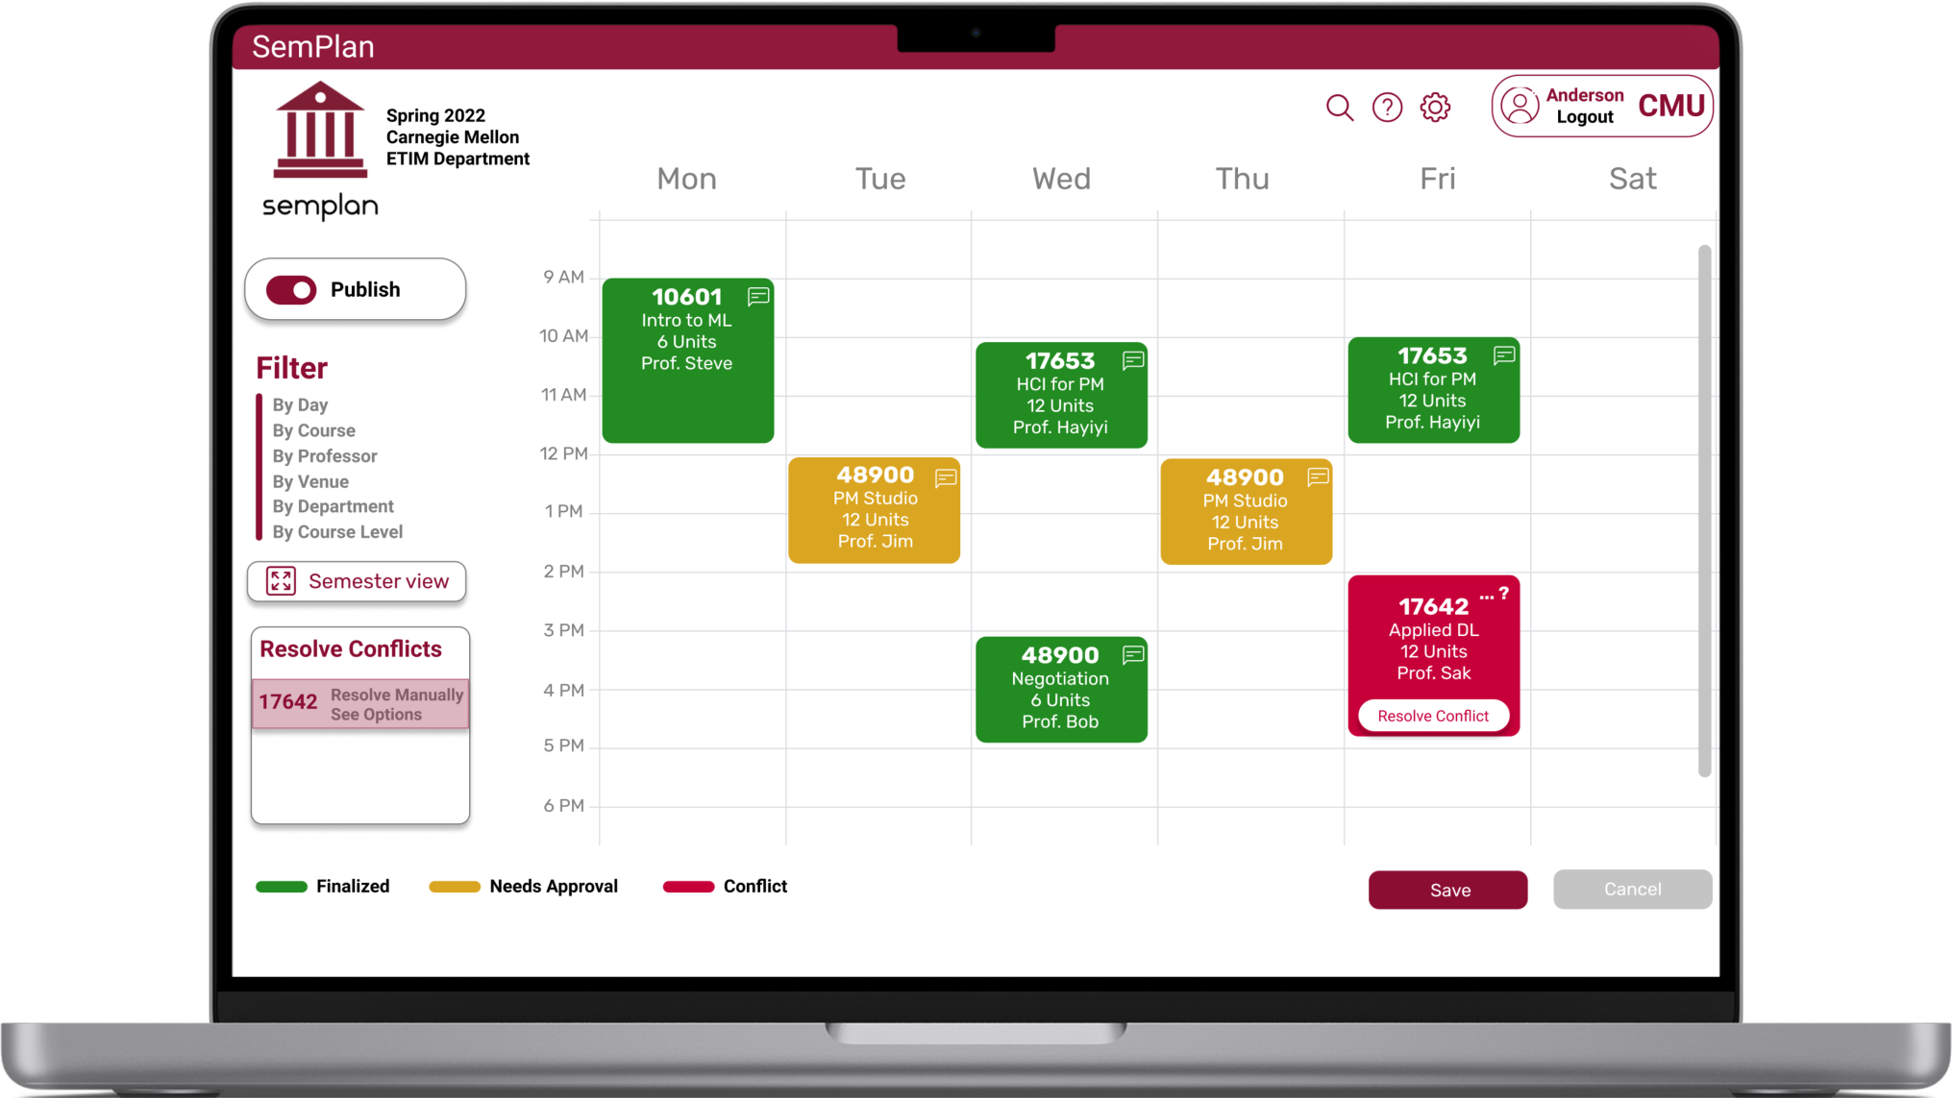

Slide 13
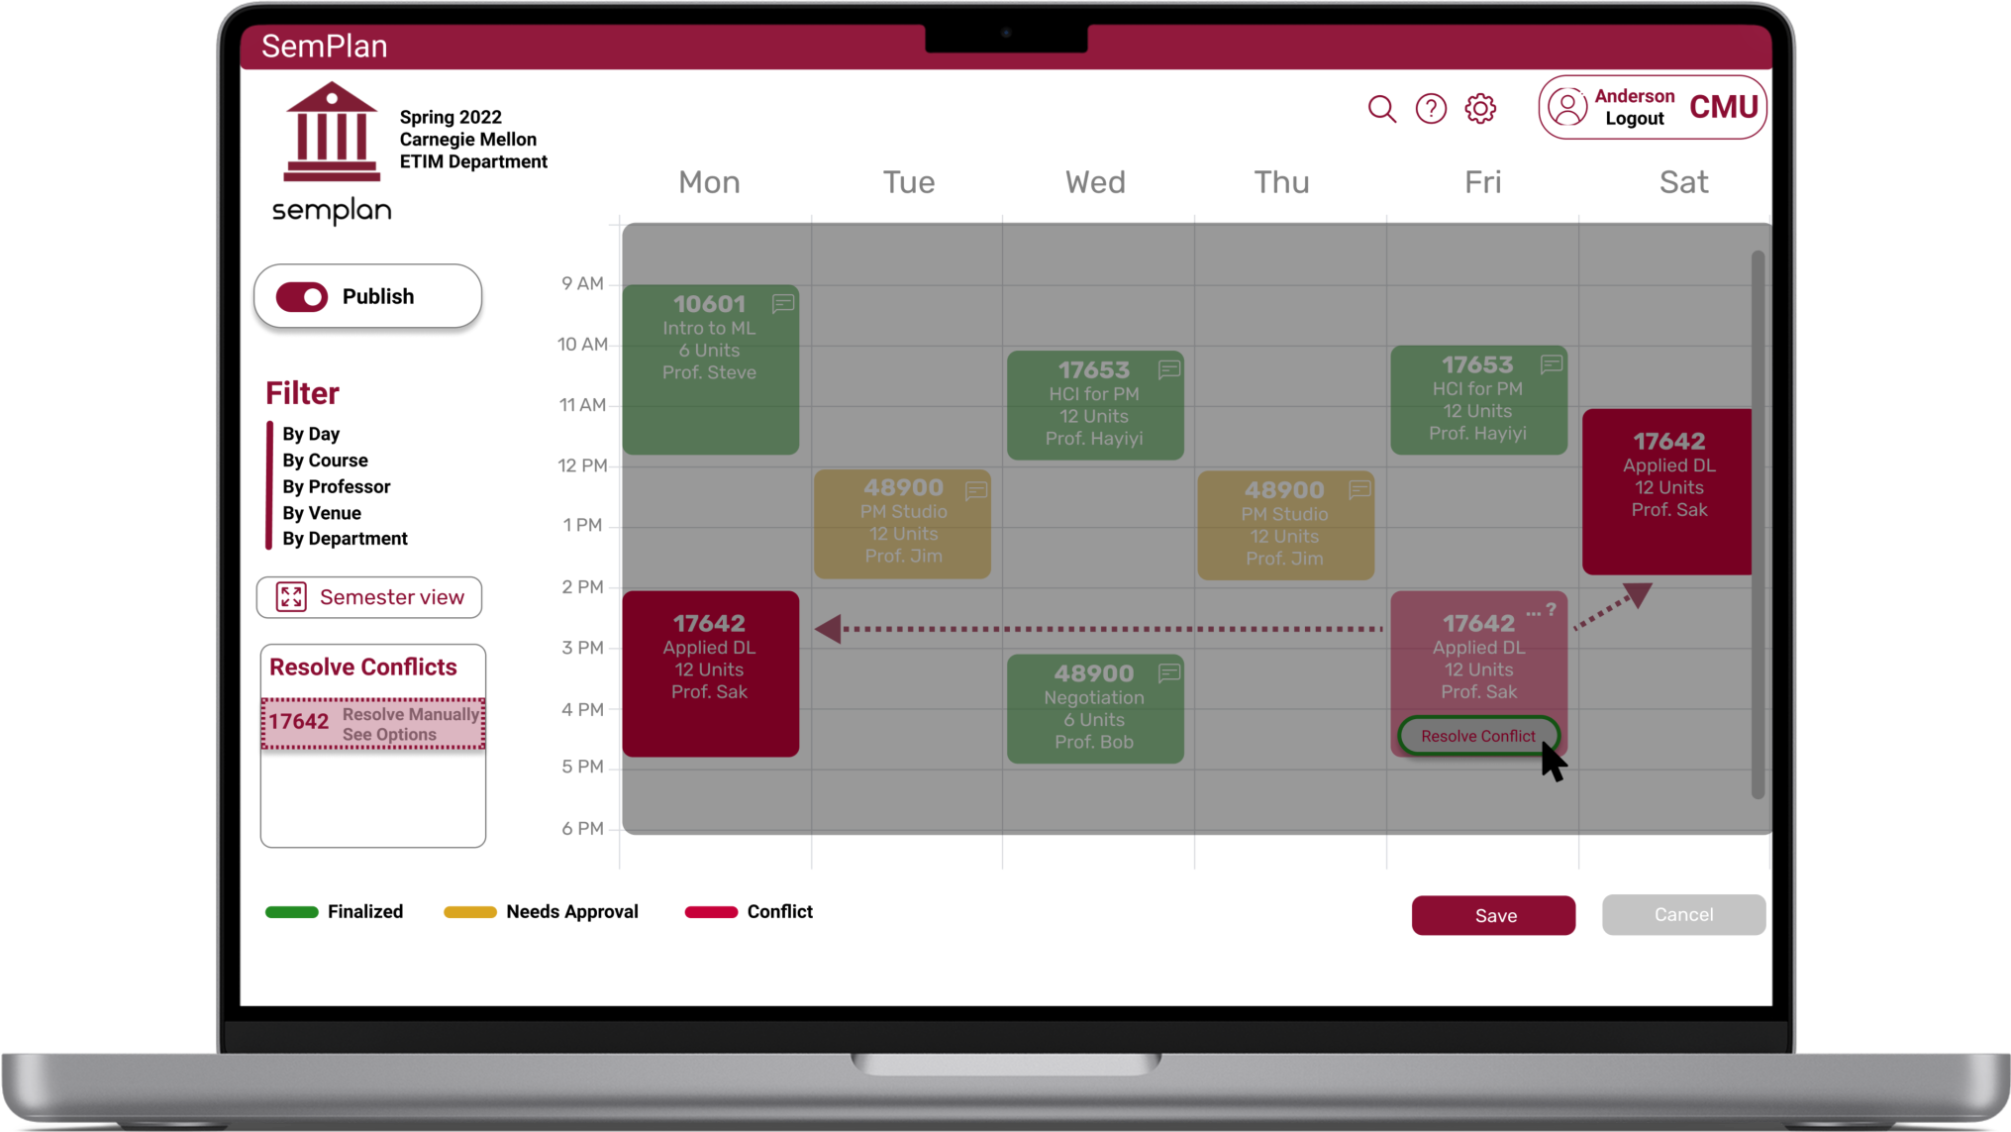

Slide 14
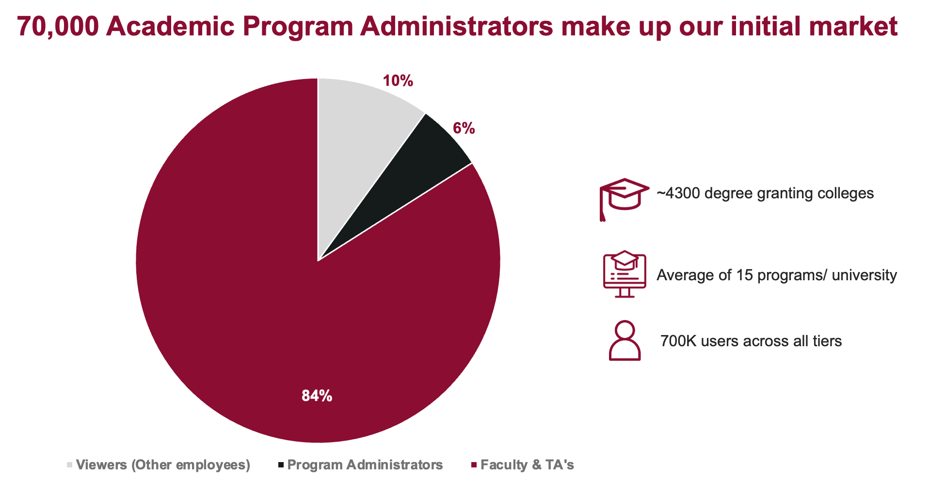

Slide 15

Save time and make PAs happy
Challenges
Benefits
Time wasted in extra effort & poor efficiency in collaboration
Reduces time taken by tasks involved in course scheduling by 50% (about 30 hrs)
Work is not enjoyable and can be very stressful
Boosts work satisfaction
Notes:
Vague of the value - two weeks work, it will be xx hours
how much comparation time / email sent decreased by transparency
satisfaction is measurable （by rate survey
Photos deleted - use a link to combine the cha & bene?
hOW TO DELIVER BENEFITS to avoid repeti
Time used to compare

Slide 16


One platform for all needs
 | Course Info management | Schedule Visualization | Communicate with stakeholders | Real-time Scheduling | AI based Insights
Excel
S3
Google doc
Email
Whiteboard
SemPlan
One time
$140
Annual
$70
Each
$35
Notes:
$50 - whiteboard
Email - free
Google doc - $70 / year ( business version
S3 - unknown
Excel - $140 one time ?
Semplan - $120 per year
The point is to show how we get $120 ( or we can use canvas similarity + excel comparation

Slide 17
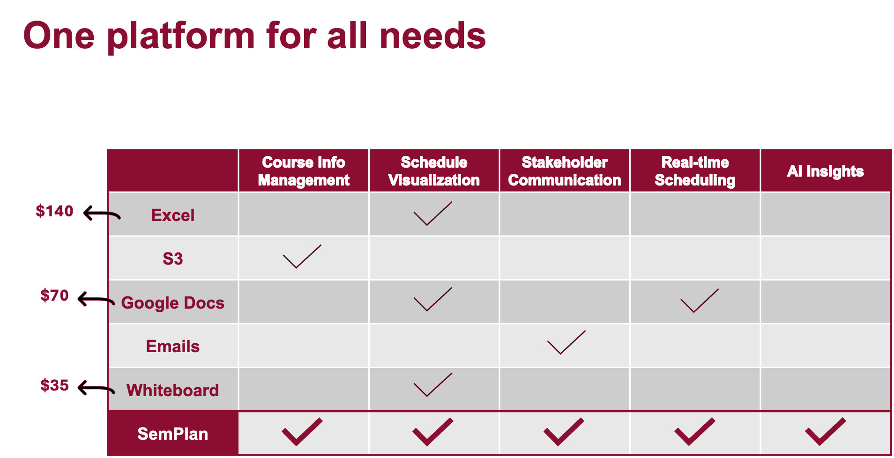

Slide 18
Our Solution offers ~7.5x benefits to cost
Annual Subscription
Pricing metric: Depends on how many programs in the organization
Similar strategy with Canvas LMS
Organization Size | Price
1 | $120
10 | $1000
100 | $8500
200 | $15000
Unlimited | $18000
Take CMU(100 programs) for example
$12,000 Cost = $90,000 Benefit
Benefit-cost ratio
7.5 : 1

Slide 19
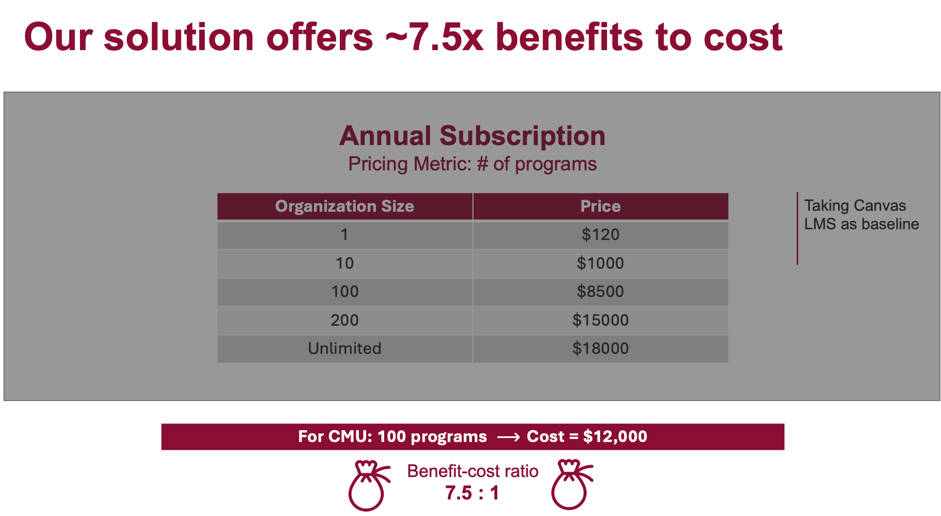

Slide 20

We recommend to go forward with SemPlan
No leader in the space of curriculum management software
Big opportunity to get a large market share
Capturing just 10% of the university market would result in approximately a recurring revenue of ~$4M/year
We need your support and resources to go forward!
Notes:
how much time / email decreased by transparency
satisfaction is measurable

Slide 21
Thank you!
Q&A

Slide 22
Appendix

Slide 23
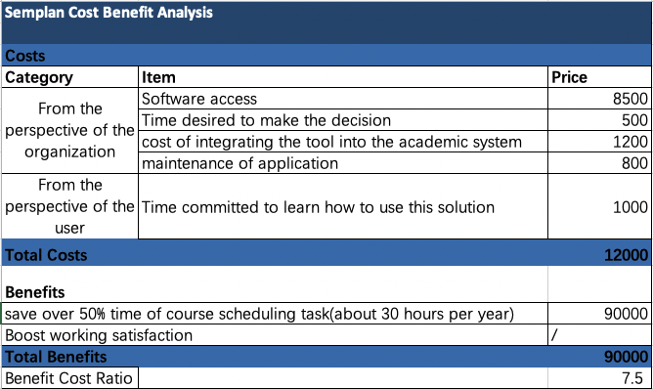
Cost-Benefit Analysis

Slide 24
Benefit Justification
Time span for course scheduling work per year | Total time spent on daily course scheduling work | Time saved by our solution | Hourly pay of Career Advisors | Total money saved for one PA per year | Total money saved an organization with 100 programs
8 weeks | 1.5 hrs per day | 30 hours | $30 | $900 | $90000

